Slide 1
Presents
OO Programming with Java
Abstract Classes
Notes:
Object-Oriented Programming with Java
Abstract Classes
Module 10

Slide 2
Learning Objectives
Learn the difference between concrete and abstract classes and how they are used
Look at how an object may be made to appear to be of a new type - Casting

Slide 3
Abstract Classes
An abstract class is a class that may not be instantiated
References can be created from an abstract class
An abstract class may include:
  attributes
  abstract Methods – These methods have no code blocks
  methods – These methods have code blocks

Slide 4
When to Use Abstract Classes
In order to use Abstract Classes, your use case should meet certain criteria.
  You have attributes and/or method implementations that you want to share with a range of subclasses.
  It should not be possible to create instances of the abstract class.
Abstract Classes are more in the realm of implementation detail than design.
Abstract Classes are generally partial classes, with placeholders for the missing parts.
  They are often part of a framework, where common behavior is factored out into a parent, abstract, class, and specific details are forcibly delegated to child classes.

Slide 5
When to Use Abstract Classes
  Consider having a DBTransaction class, where the parent provides overall management, and the individual class provides the statement handling:
    public abstract class DBTransaction {
    protected abstract Statement getStatement();
    // … other stuff …
    public void perform() {
    // prepare transaction
    do(getStatement());
    // commit or rollback
    }
    }

Slide 6
Abstract Class Example
public abstract class Car {
protected int speed;
private boolean engineState;
/* Other attributes omitted to save space */
// Each subclass must provide an implementation // of setSpeed()
public abstract void setSpeed( int speed);
public boolean getEngineState() {
return engineState;
}
/* Other methods omitted to save space */
}

Slide 7
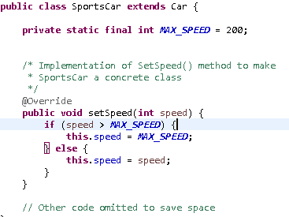
Concrete Class Example

Slide 8
Abstract Class Syntax
public abstract class Car { … }
A class that is abstract must be declared using the keyword abstract.
This indicates that it may NOT be instantiated.
Car x = new Car();
This will cause a compilation error.

Slide 9
Abstract Method Syntax
public abstract void setSpeed(int new_speed);
The keyword abstract in a method signature indicates that the method must be implemented by an extending (or “concrete”) class.
If a class does not provide an implementation for an abstract method it inherits, it must also be declared abstract – or the code will not compile.
Note: It is possible for an abstract class to have no abstract methods.

Slide 10
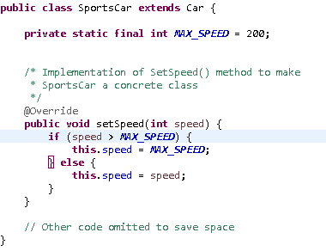
Building a “Concrete” Class
A concrete class extends an abstract class and provides an implementation for all inherited abstract methods:

Slide 11
Key Design Implications
A class provides general functionality and data fundamental to all subclasses; however, such functionality may not make sense on its own, and that is when we make it an abstract class.
Abstract Classes collectively specify a list of methods that all concrete subclasses must implement.
In the sense that they specify a list of required methods, Abstract Classes act a bit like Interfaces, which are the subject of the next unit, but Abstract Classes are classes so:
  They are restricted to single inheritance
  They can provide attributes (data)
  They can provide method implementations.
Notes:
An abstract class can provide general functionality and data fundamental to all concrete subclasses through implemented methods; however such functionality does not make sense on its own.
The abstract class Primate defines a single abstract method called useOpposableThumb ().
Pete is an object of class Human that extends Primate and provides an implementation for useOpposableThumb ().
Kong is an object of class Chimpanzee that extends Primate and provides an implementation for useOpposableThumb ().
Both Human and Chimpanzee are real types, Primate is just a generic type – there are no objects that are simply primates – they are all specializations of a concept.

Slide 12
Using Abstract References
It is possible to assign concrete objects to abstract references:
Car mySportsCar = new SportsCar();
However, in this example, mySportsCar only has access to the attributes and methods defined in Car. Methods defined in SportsCar are NOT available to it:
boolean x = mySportsCar.getEngineState();
// no problem this is a method in Car
mySportsCar.race();
/* this will not compile – Car doesn’t have a definition for race() – it’s a SportsCar method! */
Notes:
References define the available interface when they reference a child object.

Slide 13
Using Abstract References (con’t)
This enables us to write what is often called polymorphic code, the ability for unrelated classes to respond to common messages - we’ll address this in detail later.
This technique also allows us to group objects that are similar as long as we work only with the attributes and methods they have in common.
See the example on the next slide.

Slide 14

Using Abstract References (con’t)
The method below will accept ANY class that extends Car. This includes SportsCar, Cargo, SUV and StationWagon.
All classes that extend Car are required to have a setSpeed() method. So we know that the line aCar.setSpeed(55) will work.
Notes:
The power of this technique will be more clear when we cover Collections.
A collection holds objects which are not necessarily all the same type.
Using abstract references within a loop we can read through ALL of the elements of a collection and process each one in the same way.

Slide 15
Casting: An Introduction
In Java, classes are arranged in a strict hierarchy. Every class – except class Object – has one superclass and can have any number of subclasses.
Our SUV class, for example, inherits from Cargo, which in turn inherits from Car which inherits from Object.
Object
Java guarantees that:
Car will have all the attributes and methods of Object but not Cargo or SUV
Cargo will have all the attributes and methods of Car and Object but not SUV
SUV will have all the attributes and methods of Cargo, Car and Object
Car
Cargo
SUV

Slide 16
Upcasting
Because of these guarantees Java allows us to regard an object as any one of the classes from which it inherits.
So we can choose to regard an SUV as a Cargo object, a Car object or even just a plain old Object .
When we do this we lose access to the attributes and methods added in the subclass.
Regarding a class as one of its superclasses is called upcasting.

Slide 17
Upcasting Syntax
We’ve already seen one way to upcast:
Car myCar = new SportsCar();
But what if we already have a SportsCar and want to create a Car reference to it? Well, we could do this:
SportsCar mySportsCar = new SportsCar();
Car myCar = (Car) mySportsCar;
However, the cast is unnecessary, because SportsCar is-a Car; you can still simply assign without the cast.
As we continue through this class we’ll see a variety of ways in which this is useful.

Slide 18
Design Implications
Consider that the abstract class Car has an abstract method in it named setSpeed(). Each class that extends Car must provide a code body for that method.
Question: If you upcast some objects to Car and call their setSpeed() methods, what happens?
Answer: Java will call the specific method in the subclass. An example follows:

Slide 19
Example
Let’s add some code to our Car example to help clarify things.
First let’s make the Cargo class an abstract class – it can’t be instantiated but we'll give it a concrete method for setSpeed(int). This method will serve as the default setSpeed() method for all vehicles that extend Cargo.
The code for this is shown on the next slide. We will subtract 1% of the current cargo weight from the speed.

Slide 20
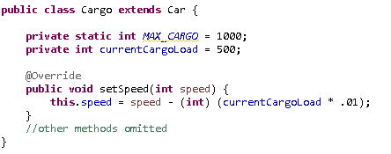
Example: The Cargo class

Slide 21
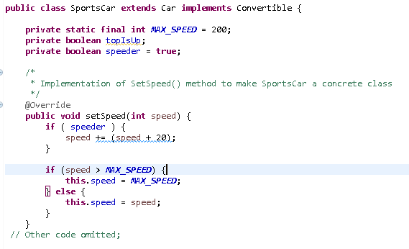
Example: The SportsCar class
Notes:
Drivers of SportCars might be speeders. If the speeder attribute is true, the speed will be altered by adding 20 to it.

Slide 22
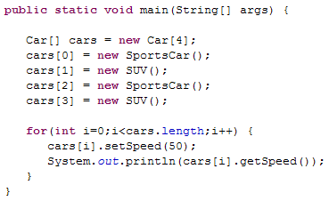
Example: Calling the setSpeed method
Now we’ll create an array of Cars and put some SportsCars and SUVs in it, and use a loop to set each speed to 50.
When we run this code it will print out:
  70
  45
  70
  45
Do you see why?

Slide 23
Example Concluded
When the Car is actually referring to a SportsCar, Java calls the setSpeed()method for SportsCar. But when the Car is an SUV, Java calls the Cargo setSpeed() method (inherited by SUV).
This common manipulation is called polymorphism.
Java limits you to calling the methods that are defined in the cast. This ensures that a method with that signature exists.
BUT when the method is executed, Java uses the code for the overridden method in the actual object.

Slide 24
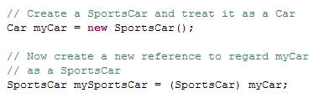
Downcasting
Downcasting lets us take a class that has been upcast to a more general class and switch back to regarding it as a more specific class.
Downcasting is the only time when we must cast object references.
For example:
Notes:
Downcasting may result in a ClassCastException being thrown – so be careful!

Slide 25
Issues with Casting
In many cases Java can check at compile time to ensure that you’ve got the correct type.
But this is not always so. Java will not always be able to determine that you’ve specified the right types when it compiles your code.
  Remember that we had exactly this problem when implementing the equals() method.
So, if you make a mistake you may encounter a run time error.

